Slide 1
MARZO 7, 2023

Slide 2
What is a DFS
Distributed File System
Long term info storage
Access result of a process later
Enable Access to multiple processor
Administration in a OS is provided by File System

Slide 3
What is a DFS
HIGH CONCURRENCY
VS
LOW CONSISTENCY
Data partitioning,
data replication→
Data scalability, Fault tolerance, High concurrency

Slide 4
Scalable computing over Internet
Commodity clusters, parallel computer with an average of computing nodes. Not powerfull as parallel computers, but are more generic.
In internet is called SoC (Service oriented Computing)

Slide 5
Models for Big Data
Programming Models = abstractions
Runtime libraries + Programming lenguages
Programming Big Data Model➔Programmability on top of DFS

Slide 6
Models for Big Data, requeriments
Support BD operations:
Split volumes of data
Access data fast
Handle Fault tolerance
Replicate data partitions
Recover files
Enable adding more racks
Optimized for specific data sets

Slide 7
4W’s and 1H
What is in Ecosystem?
Why is beneficial?
Where is it used?
Who uses it?
How do these tools work?

Slide 8
When consider Hadoop
Future anticipated data growth
Long term availability data
High Volume and variety
Multiple apps over the same data store
Data parallelism approach
Security (ranger from apache Project)
Analytical Queries (tez from apache Project)
Latency sensitive (drill & storm apache Project)

Slide 9
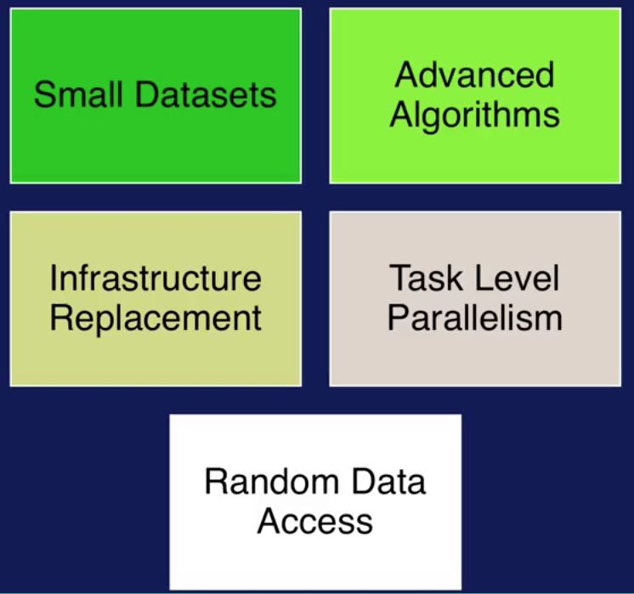
When consider Hadoop(2)

Slide 10
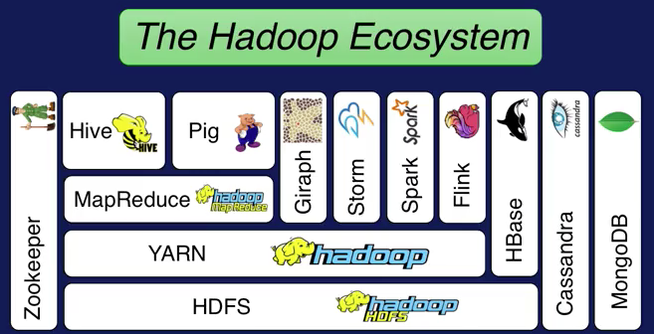
What Hadoop offers and goals
Enable Scalability, to store large volumes of data
Handle Fault Tolerance
Optimized for Variety data types
Facilitate a Shared environments
Provide value

Slide 11
Hadoop Stack
HDFS (Hadoop Distribuited File System)
Goal: Increase storage capacity using commoditie software
YARN (Yahoo)
Goal: Schedule Jobs and resource manager over HDFS storage
MapReduce (Google)
Goal: programming model to simplify parallel computing

Slide 12
Hadoop Stack
HIVE (Facebook) AND PIG (Yahoo)
Goal: Augment data model used by MapReduce. Using Relational Algebra and Flow modeling, respectively.
GIRAPH
Goal: processing graphs efficiently, as Facebook.
STORM, SPARK, FLINK
Goal:Real time and in memory processing Big Data, 100x times more than Yarn

Slide 13
Hadoop Stack
Hbase, Cassandra (Facebook) and MongoDB
Goals: Process Key-value and large sparse tables collections (NoSQL)
Zookeeper (Yahoo)
Goal: Centralized management system for sync, config and ensure high availability

Slide 14
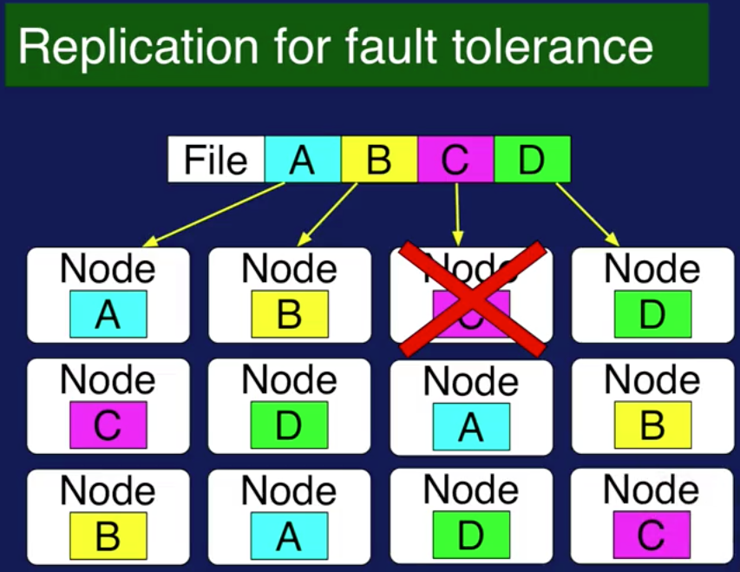
HDFS storage
Goals:
Scalability for big data sets
Reliability for hardware faliures
Capacity: >200 PetaBytes, 4500 servers, 1 billion files. Every file is segmented by blocks of 64 MB, and 3 copies of
Each block,

Slide 15
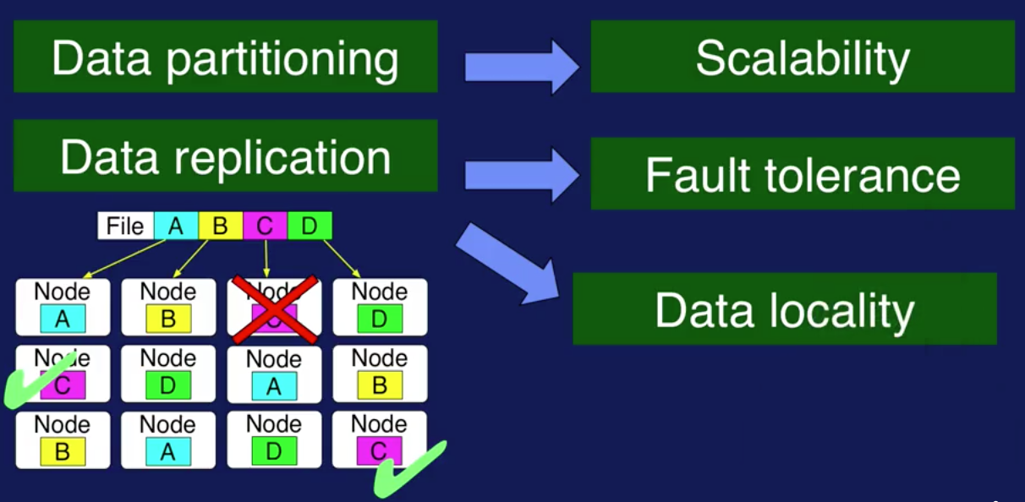
HDFS Components
Name Nome (master).- storage meta data and one per cluster. Coordinates operartions. File replication map
Slave Node(s) (Slave(s)).- block storage in every node in the cluster (creation, deletion and replication(fault tolerance and Data locality)

Slide 16
YARN (Yet Another Resource Negotiator)
Resource manager.
Interacts with applications and Schedule resources for their use.
Allow to run multiple applications over HDFS even using parallel computing
RESOURCE MANAGER(resources) + NODE MANAGER(jobs)
DATA COMPUTATION FRAMEWORK

Slide 17
MapReduce
Is the programing model for Hadoop, executing parallel processing over distribuited blocks in HDFS
MAP.- apply operation to all elements
REDUCE .- summarize operation in elements

Slide 18
Ingestion
The process to getting data into the used data system.
How many data sources?
How large data systems?
Will the number of data sources?
Rate of data ingestion?
What do with big data? (Ingestion policy)
What to do when data is to little or to much?(ingestión policy)

Slide 19
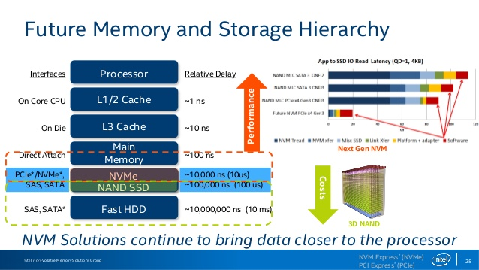
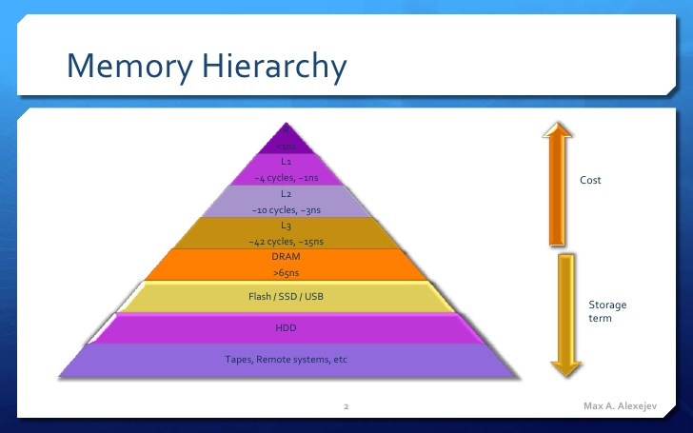
Storage
When hardware meets data management
How much data to store? (directly attached or network attached)
How fast do we need to read/write?

Slide 20
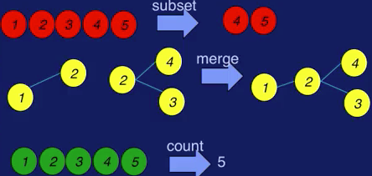
Big Data Operations
Document, define, implement and test the set of operations required for specific application.
Some are independent of data types, other requires the nature of the data.
Operations on single data-item that produce sub-item
Operations on collections of data items

Slide 21
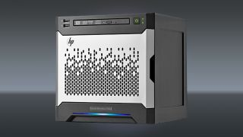
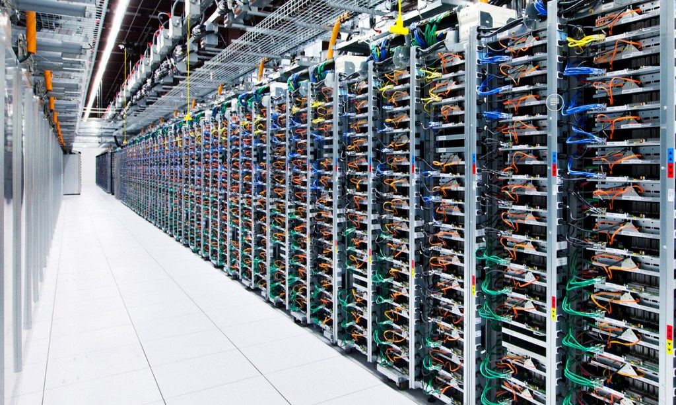

Scalability & Security

Slide 22
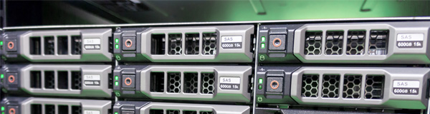
NAS vs SAN vs DAS

Slide 23
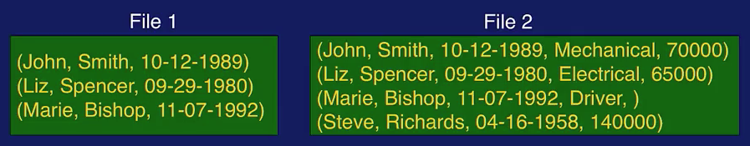
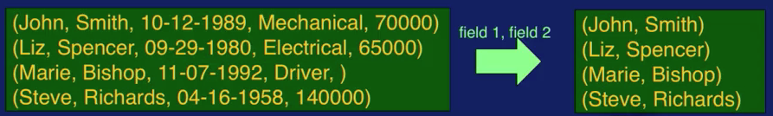
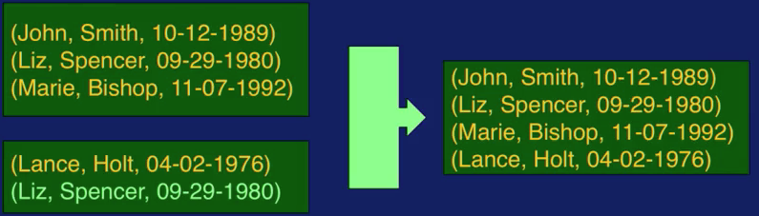
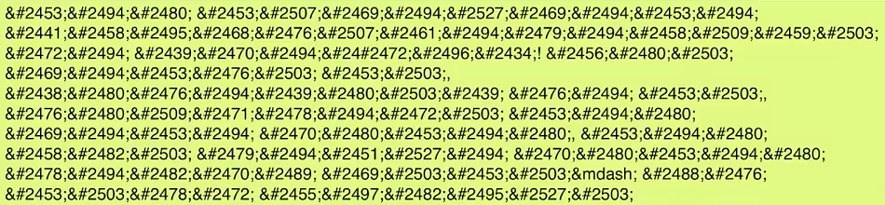
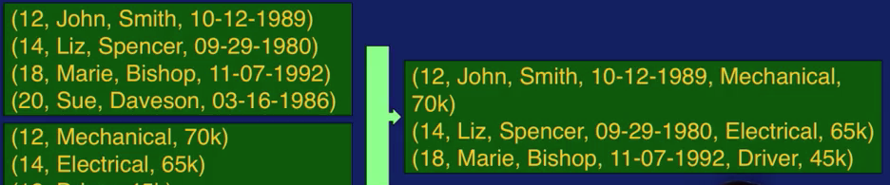
Data models
1. Structures
Structured or Non Structured data, Data with how much repeatable patterns of data
2. Operations
Subsetting (selection or filtering)
Extract a set of information
Substructure extraction (projection)
Union
Join

